Slide 1
HTTP Requests
-by-
Priyamanga Bhardwaj
Sindhu K
Shishir
Tejaswini
Pavan Kalyan

Slide 2
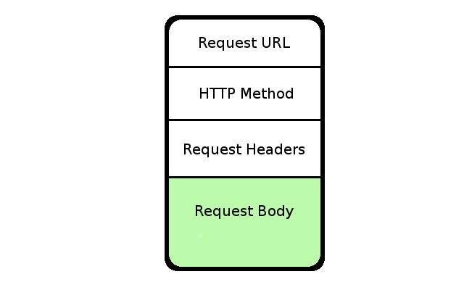
Introduction…

Slide 3
An HTTP client sends an HTTP request to a server in the form of a request message which includes following format:
A Request-line,
Zero or more header (General|Request|Entity) fields,
An empty line (i.e., a line with nothing preceding the CRLF) indicating the end of the header fields,
Optionally a message-body.
The Request-Line begins with a method token, followed by the Request-URI and the protocol version, and ending with CRLF. The elements are separated by space SP characters.
Let's discuss each of the parts mentioned in the Request-Line.

Slide 4
The request method indicates the method to be performed on the resource identified by the given Request-URI. The method is case-sensitive and should always be mentioned in uppercase. The following table lists all the supported methods in HTTP/1.1.
GET - The GET method is used to retrieve information from the given server using a given URI. Requests using GET should only retrieve data and should have no other effect on the data.
HEAD - Same as GET, but it transfers the status line and the header section only.
POST - A POST request is used to send data to the server, for example, customer information, file upload, etc. using HTML forms.
PUT - Replaces all the current representations of the target resource with the uploaded content.
DELETE - Removes all the current representations of the target resource given by URI.

Slide 5
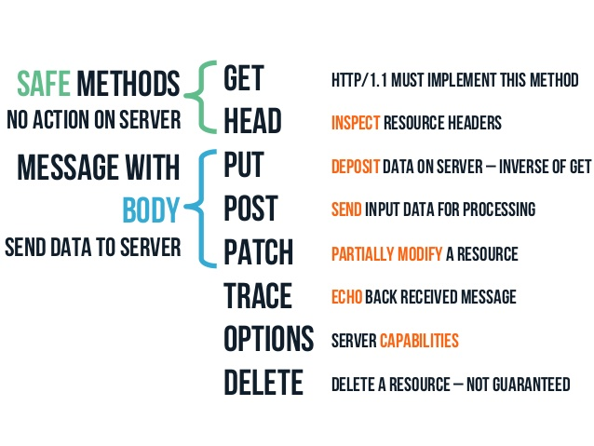
CONNECT - Establishes a tunnel to the server identified by a given URI.
OPTIONS - Describe the communication options for the target resource.
TRACE - Performs a message loop back test along with the path to the target resource.

Slide 6
Request Header Fields - The request-header fields allow the client to pass additional information about the request, and about the client itself, to the server. These fields act as request modifiers. Here is a list of some important Request-header fields that can be used based on the requirement:
Accept-Charset
Accept-Encoding
Accept-Language
Authorization
Expect
From
Host
If-Match
If-None-Match
If-Range
If-Unmodified-Since
Max-Forwards
Proxy-Authorization
User-Agent
Request-URI
The Request-URI is a Uniform Resource Identifier and identifies the resource upon which to apply the request.

Slide 7
Example of Request Message
GET /hola.htm HTTP/1.1
User-Agent: Mozilla/4.0 (compatible; MSIE5.01; Windows NT)
Host: www.JARVIS.com
Accept-Language: en-us
Accept-Encoding: gzip, deflate
Connection: Keep-Alive
POST /cgi-bin/process.cgi HTTP/1.1
User-Agent: Mozilla/4.0 (compatible; MSIE5.01; Windows NT)
Host: www.JARVIS.com
Content-Type: application/x-www-form-urlencoded
Content-Length: length
Accept-Language: en-us
Accept-Encoding: gzip, deflate
Connection: Keep-Alive
licenseID=string&content=string&/paramsXML=string

Slide 8
THANK YOU !!

